Slide 1
Competitive Programming
Presented by
Md. Momenul Haque
Lecturer, Dept. of CSE

Slide 2
National Collegiate Programming Contest 2020
IEEEXtreme Programming Competition (24 hours)
IUPC: RUET CSE FEST 2K22
My CP Journey
ICPC Asia Dhaka Regional Contest 2021
ICPC Asia Dhaka Regional Contest 2023 (Coach)

Slide 3
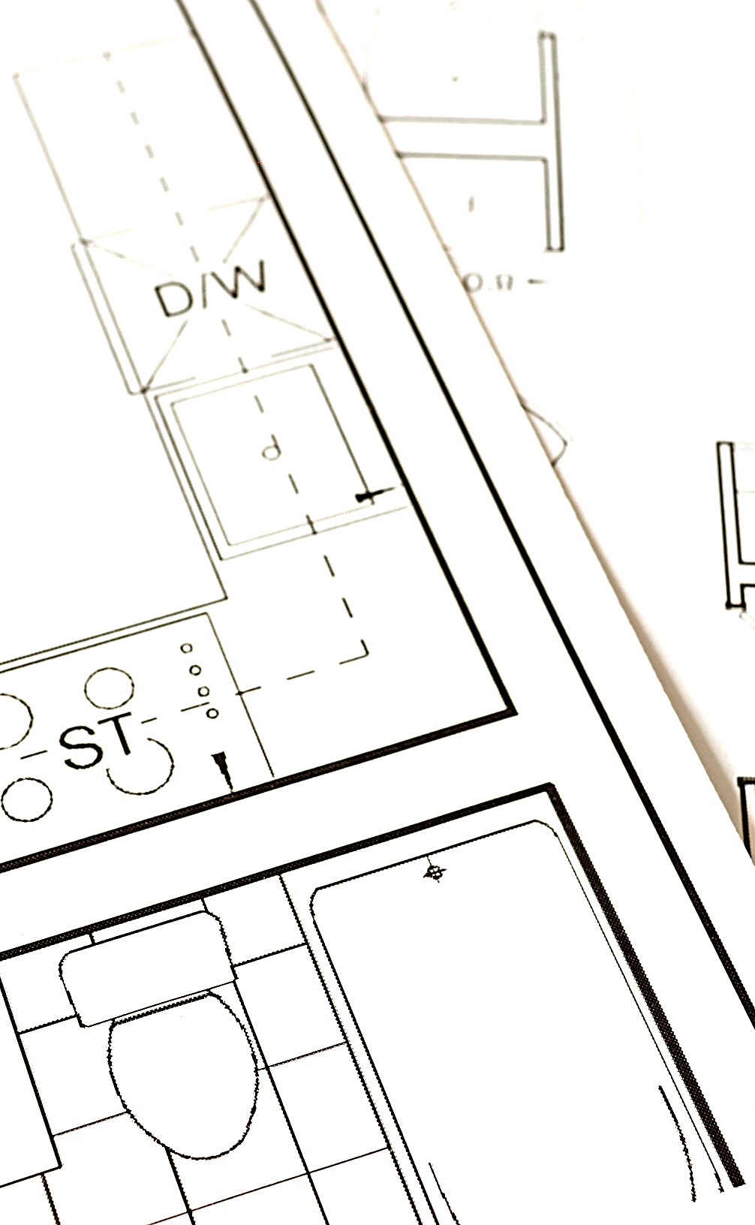
DISCUSSION OUTLINE
- What is CP?
- Why CP?
- Goal
- Roadmap
- Resources
- Benefit
TODAY'S PRESENTATION

Slide 4
- mind sport where everyone showcase his/her skills of problem solving under various constraints
WHAT IS CP ?

Slide 5
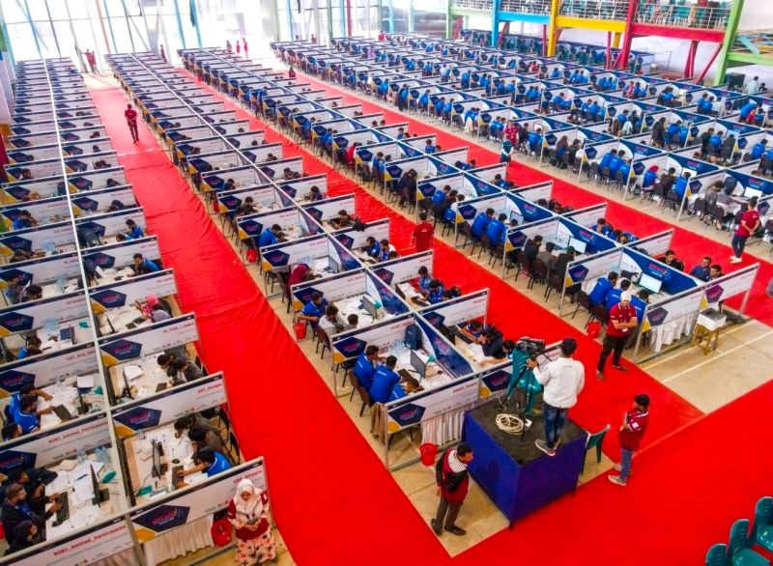
- mind sport where everyone showcase his/her skills of problem solving under various constraints

Slide 6

WHY CP ?
Cz it's Trend now
“To prepare a programmer such that his/her logical building ability increases and he/she is able to write code for the challenging situation.”

Slide 7











Top Companies Hiring
Policy

Slide 8
Not to be Competitive
Programmer,
To be good ranker Competitive
Programmer
Goal
Add a subheading

Slide 9




Select any one language and learn it
Learn about
time complexity &
Space complexity
Learn DSA
Give the contest
and practice for various problems
Suggestion C++..
Practice..Practice..Practice..
ROADMAP

Slide 10
same problem is given to the both person
solve by
bruteforce(naive) aproach
PERSON 1
Who Know the DSA but never tried CP
solve Problem by
existing algorithm with
Lowest Time Complexity
PERSON 2
who know the DSA and Doing CP too.

Slide 11
How to start???
C++ Basics
RESOURCE
Youtube: (Basics)
CodeWithHarry (Hindi), Anisul Islam (Bangla), Programming with Mosh (English)
Youtube: (Advance)
CodeVault
Website:
w3schools.com, tutorialspoint.com
youtube
Website

Slide 12
https://codeforwin.org/c-programming/basic-programming-practice-problems
WHERE TO Start?

Slide 13
https://cses.fi/problemset/
https://codeforces.com/problemset?order=BY_SOLVED_DESC
https://www.codechef.com/
https://atcoder.jp/
https://www.spoj.com/
https://vjudge.net/article/2315
WHERE TO DO CP?

Slide 14
https://vjudge.net/contest/740606
WHERE TO DO CP?

Slide 15
Learn STL:
(Apna College)
https://youtu.be/l0RrDYr2pGE
(GeekforGeeks): https://www.geeksforgeeks.org/cpp/the-c-standard-template-library-stl/
Learn DSA:
https://youkn0wwho.academy/topic-list/
https://discuss.codechef.com/t/data-structures-and-algorithms/6599
WHERE TO BECOME PRO?

Slide 16
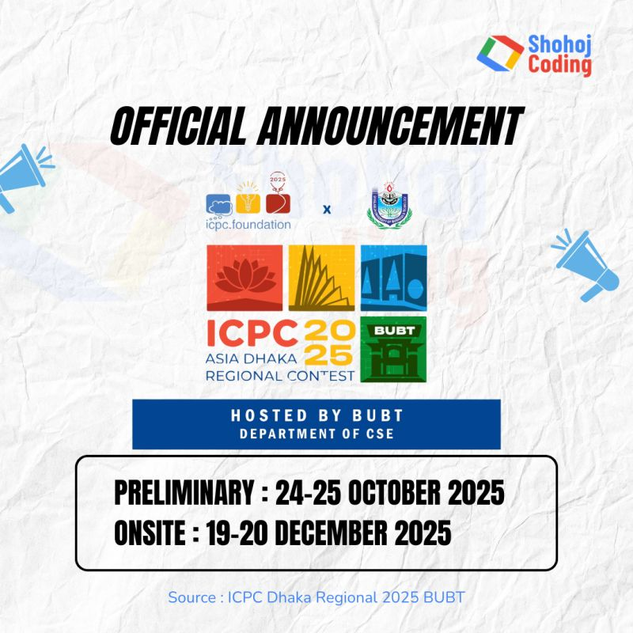
What Next?

Slide 17
Benifits of CP
It’s a way to publicly demonstrate your skills
Get Problem Solving & logic building Skill
Help to Crack Coding interviews
Improve Your Resume Profile

Slide 18

TO Be Master In CP
Practice...Practice...Practice
WORDS OF WISDOM

Slide 19

Questions ?
Thank You

